Slide 1

Sturents
A vision brought to you by
Rental Central

Slide 2
Functionality
Ability to scrape Kijiji listings for student targeted home rentals
Push found listings to a JSON file locally on the app
App returns the JSON in a visual list with swiping capabilities, left for no, right for yes
Saves swiped right listing into a JSON file locally on app for the users to browse their selected listings.
Can click listings to open more detailed discriptions

Slide 3
Simulated (to be implemented)
Scraper automatically crawls websites every 12 hours
Push the scraped listings into Amazon RDS
App parses table to local JSON
User can open saved list and click listings to push the user to a email lister, if no email is listed push user to the URL of the listing
Facilitate a more OOP style

Slide 4
Difficulties
Setting up the cloud architecture
Figuring out most effective way to store data in the RDS
Initially using python to scrape, this was very slow, transitioned to nodeJS

Slide 5
Roadmap
Refine user UI to be aesthetically pleasing
Automate web scraper on Amazon EC2 instance
Store all listings on RDS
End user queries RDS for a smaller JSON related to their GPS location

Slide 6
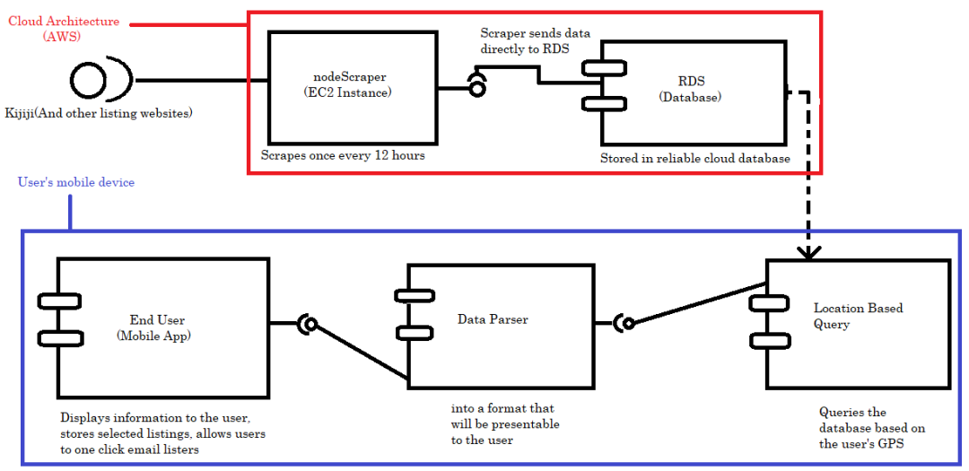
Component diagram

Slide 7
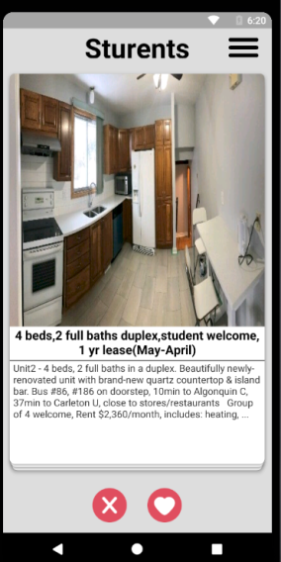
demo

